Slide 1

CSI-317
Theory Of Computing

Slide 2
Part-I Automata Theory

Slide 3
Chomsky Normal Form (CNF)

Slide 4
# Contents
Chomsky Normal Form (CNF)
Conversion of CFG to CNF

Slide 5


Chomsky Normal Form (CNF)
A CFG is in CNF if every rule has one of the following form.
A $→$ BC B$≠$ S and C$≠$ S
A $→$ a a $∈$ $Σ$
S $→$ $ε$ S is the start variable

Slide 6
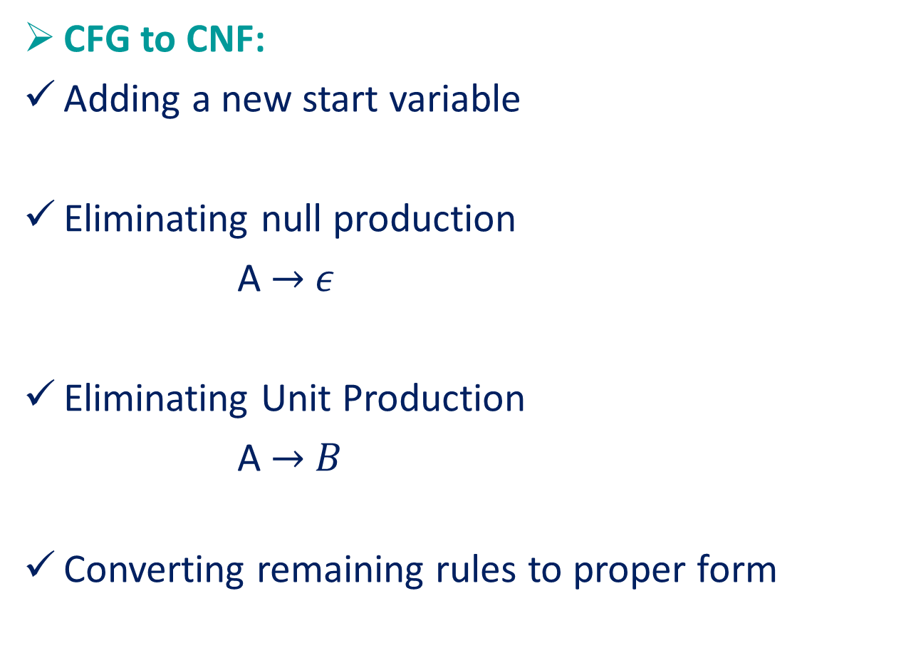
Conversion of CFG to CNF
CFG to CNF:
Adding a new start variable
Eliminating null production
A $→$ $ε$
Eliminating Unit Production
A $→$ $B$
Converting remaining rules to proper form

Slide 7
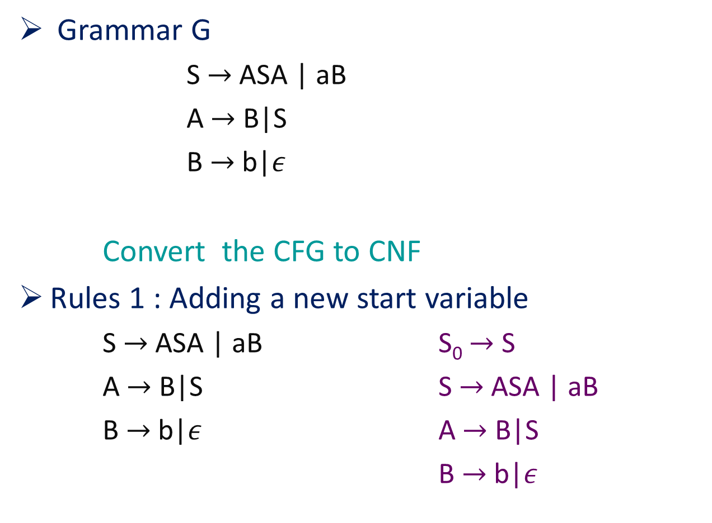
Conversion of CFG to CNF (cont.)
Grammar G
S $→$ ASA | aB
A $→$ B|S
B $→$ b|$ε$
Convert the CFG to CNF
Rules 1 : Adding a new start variable
S $→$ ASA | aB S₀ $→$ S
A $→$ B|S S $→$ ASA | aB
B $→$ b|$ε$ A $→$ B|S
B $→$ b|$ε$

Slide 8
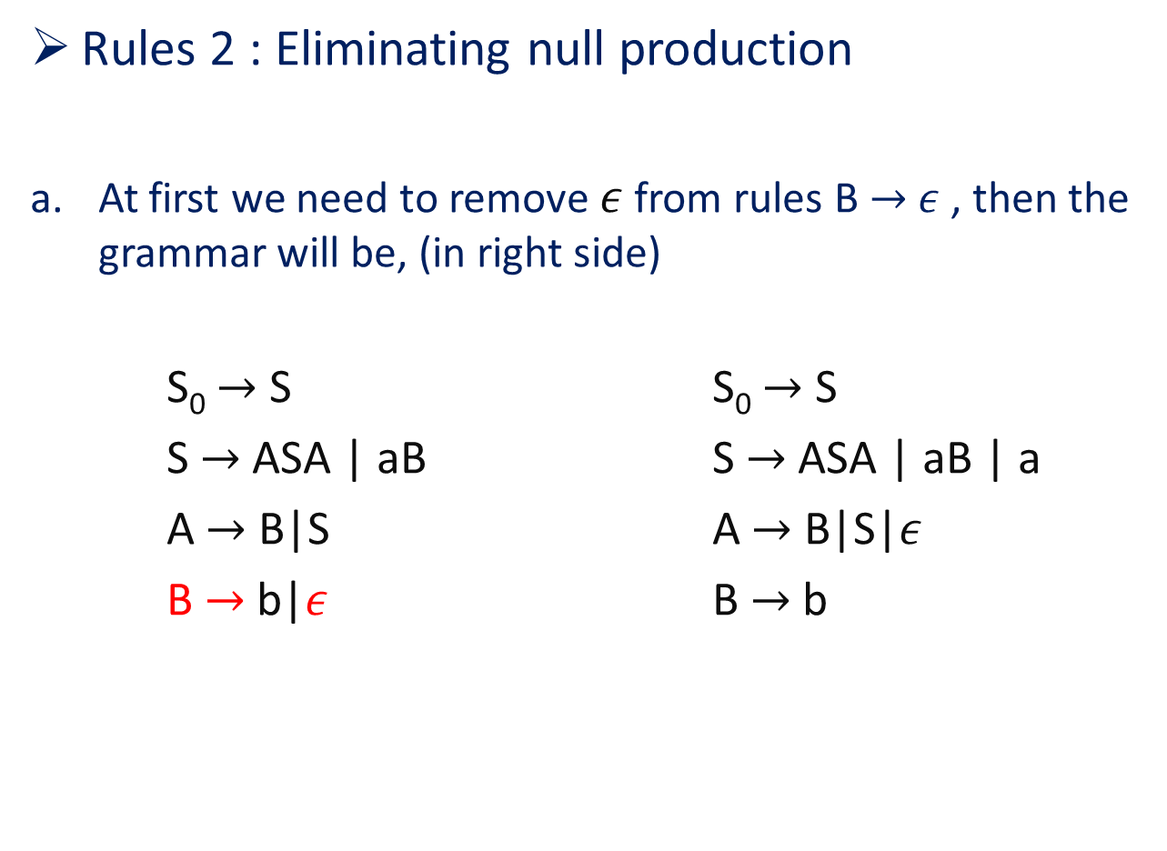
Conversion of CFG to CNF (cont.)
Rules 2 : Eliminating null production
At first we need to remove $ε$ from rules B $→$ $ε$ , then the grammar will be, (in right side)
S₀ $→$ S S₀ $→$ S
S $→$ ASA | aB S $→$ ASA | aB | a
A $→$ B|S A $→$ B|S|$ε$
B $→$ b|$ε$ B $→$ b

Slide 9
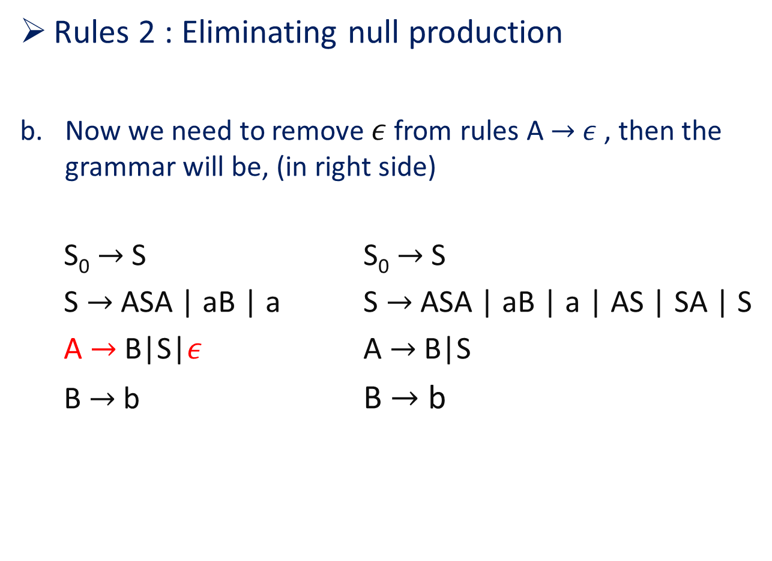
Conversion of CFG to CNF (cont.)
Rules 2 : Eliminating null production
Now we need to remove $ε$ from rules A $→$ $ε$ , then the grammar will be, (in right side)
S₀ $→$ S S₀ $→$ S
S $→$ ASA | aB | a S $→$ ASA | aB | a | AS | SA | S
A $→$ B|S|$ε$ A $→$ B|S
B $→$ b B $→$ b

Slide 10
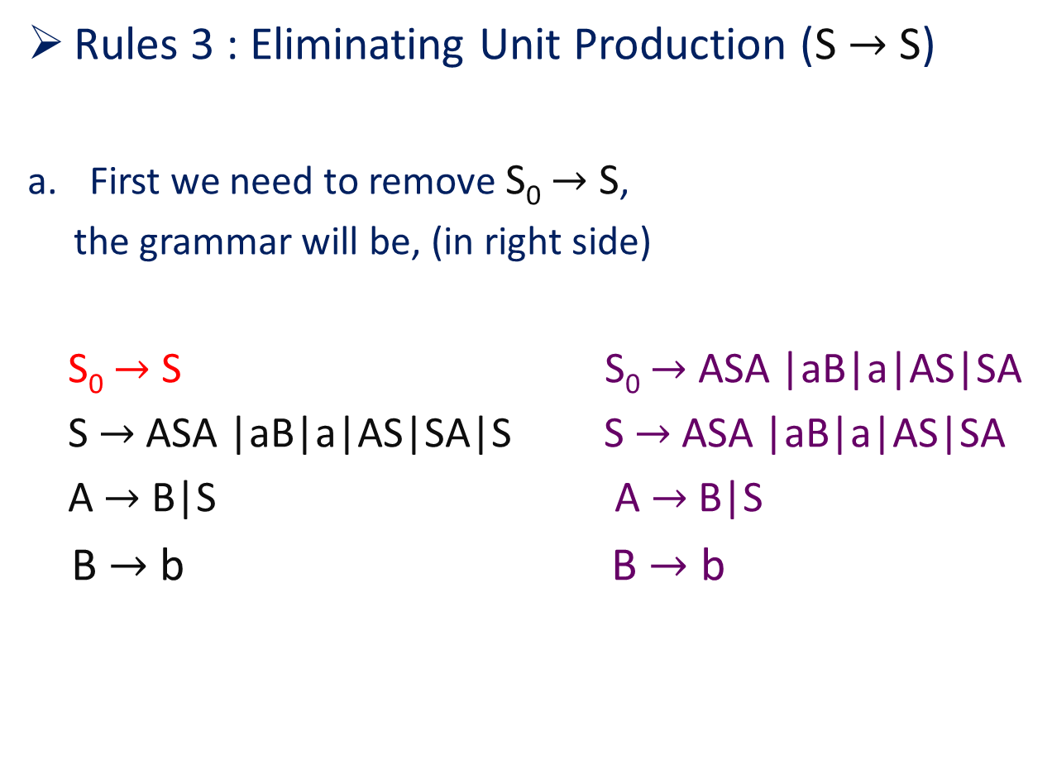
Conversion of CFG to CNF (cont.)
Rules 3 : Eliminating Unit Production (S $→$ S)
First we need to remove S₀ $→$ S,
the grammar will be, (in right side)
S₀ $→$ S S₀ $→$ ASA |aB|a|AS|SA
S $→$ ASA |aB|a|AS|SA|S S $→$ ASA |aB|a|AS|SA
A $→$ B|S A $→$ B|S
B $→$ b B $→$ b

Slide 11
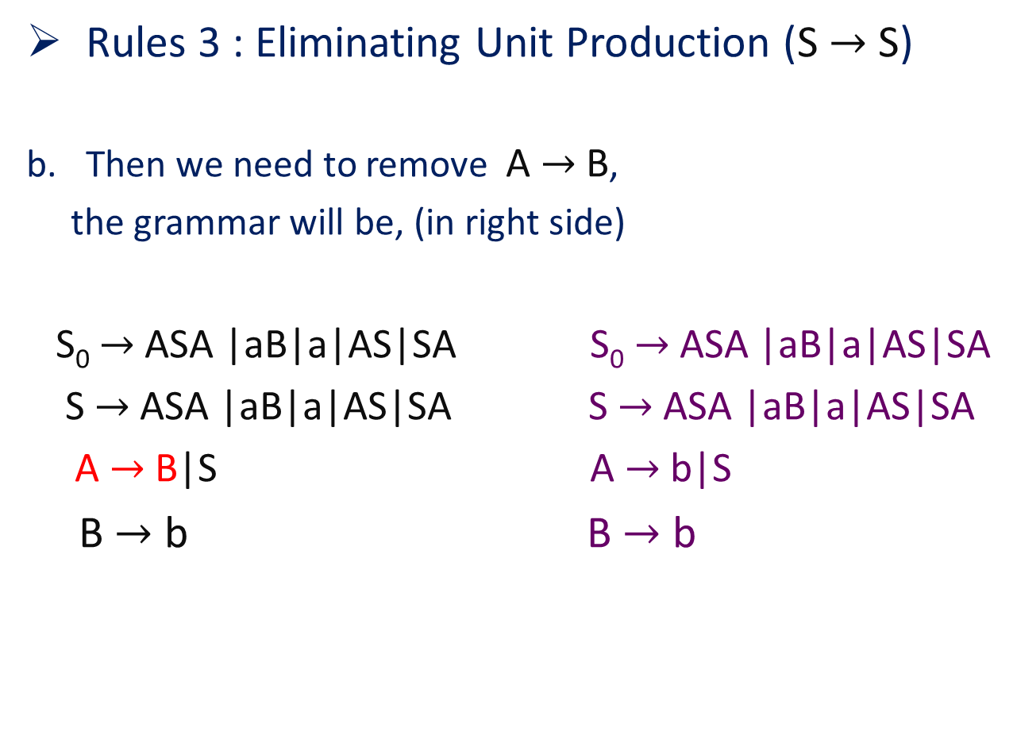
Conversion of CFG to CNF (cont.)
Rules 3 : Eliminating Unit Production (S $→$ S)
Then we need to remove A $→$ B,
the grammar will be, (in right side)
S₀ $→$ ASA |aB|a|AS|SA S₀ $→$ ASA |aB|a|AS|SA
S $→$ ASA |aB|a|AS|SA S $→$ ASA |aB|a|AS|SA
A $→$ B|S A $→$ b|S
B $→$ b B $→$ b

Slide 12
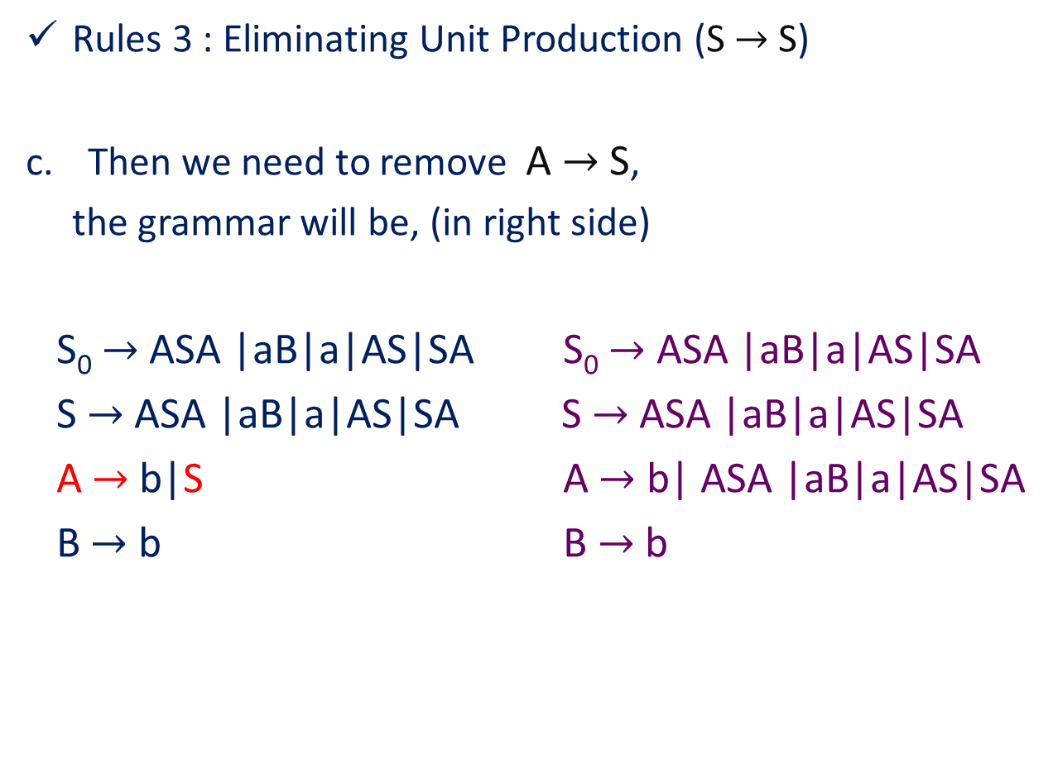
Conversion of CFG to CNF (cont.)
Rules 3 : Eliminating Unit Production (S $→$ S)
Then we need to remove A $→$ S,
the grammar will be, (in right side)
S₀ $→$ ASA |aB|a|AS|SA S₀ $→$ ASA |aB|a|AS|SA
S $→$ ASA |aB|a|AS|SA S $→$ ASA |aB|a|AS|SA
A $→$ b|S A $→$ b| ASA |aB|a|AS|SA
B $→$ b B $→$ b

Slide 13
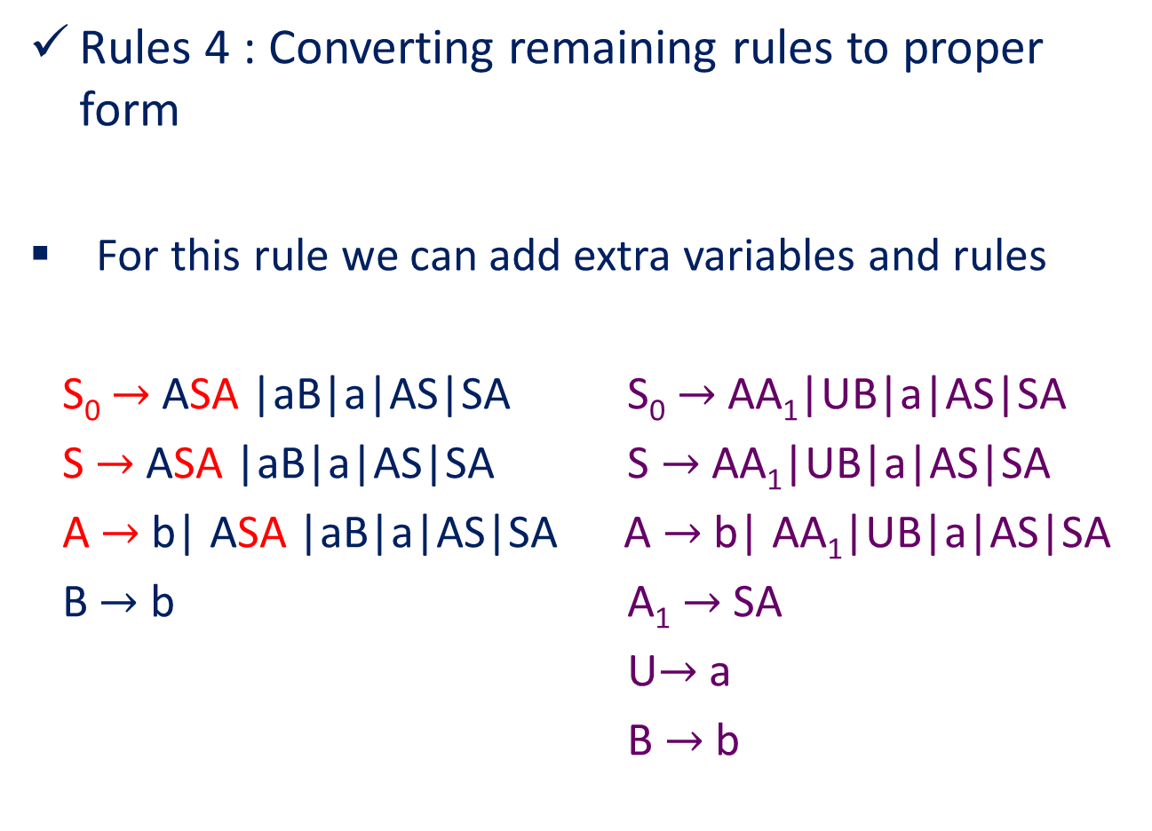
Conversion of CFG to CNF (cont.)
Rules 4 : Converting remaining rules to proper form
For this rule we can add extra variables and rules
S₀ $→$ ASA |aB|a|AS|SA S₀ $→$ AA₁|UB|a|AS|SA
S $→$ ASA |aB|a|AS|SA S $→$ AA₁|UB|a|AS|SA
A $→$ b| ASA |aB|a|AS|SA A $→$ b| AA₁|UB|a|AS|SA
B $→$ b A₁ $→$ SA
U$→$ a
B $→$ b

Slide 14
Thank You

